Slide 1

Note: The data and information in this document is reflective of a hypothetical situation and client. This document is to be used for KPMG Virtual Internship purposes only.
Sprocket Central Pty Ltd
Data analytics approach
[Division Name] - [Engagement Manager], [Senior Consultant], [Junior Consultant]

Slide 2
Note: The data and information in this document is reflective of a hypothetical situation and client. This document is to be used for KPMG Virtual Internship purposes only.
Agenda
Introduction
Data Exploration
Model Development
Interpretation

Slide 3
Identify and Recommend Top 1000 Customer to Target from Datasets
Note: The data and information in this document is reflective of a hypothetical situation and client. This document is to be used for KPMG Virtual Internship purposes only.
Introduction
Outline of Problem
• Sprocket Central is a company that specializes
high-quality bikes and cycling accessories.
.Their marketing team is looking to boost business
sales by analyzing provided datasets.
.Using the 3 datasets provided the aim is to
analyze and recommend 1000 customers that
Sprocket Central should target to drive higher
value for the company.
Contents of Data Analysis
+ 'New'and'Old'Customer Age Distributions
+ Bike related purchases over the last 3 years by gender
→ Job industry distributions
→ Wealth segmentation by age category
Number of cars owned and not owned by state
◆ RFM analysis and customer classification

Slide 4
Note: The data and information in this document is reflective of a hypothetical situation and client. This document is to be used for KPMG Virtual Internship purposes only.
Data Exploration
Data quality and assessment and ‘clean up’
Customer demographic | accuracy | completeness | consistency | currency | relevancy | validity
 | DOB inaccurate Age missing | • Job title: blanks • Customer id: incomplete | • Gender: inconsistency | Deceased customers: filter out | • Default column: delete
Customer address |  | .Customer id: incomplete | • States: inconsistency
transactions | .Profit: missing | • Customer id: incomplete • Online Order: blanks Brand:blanks |  |  | .Cancelled status order: filter out | • List price: format • Product sold date: format
Key Issues for Data Quality Assessment
Accuracy : Correct Values
• Completeness: Data Fields with Values
• Consistency: Values Free from Contradiction
• Currency : Values up to Date
• Relevancy : Data items with Value Meta-data
Validity : Data Containing Allowable Values
.Uniqueness : Records that are Duplicated
.

Slide 5
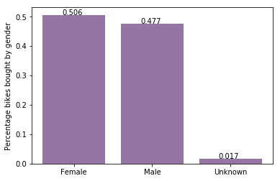
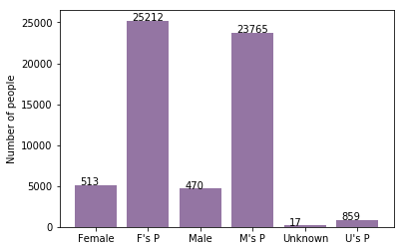
Note: The data and information in this document is reflective of a hypothetical situation and client. This document is to be used for KPMG Virtual Internship purposes only.
Model Development
t
Bike purchases last 3 years
As we can see, our new customers mostly Female with 50.6% purchases with total of 25,212 bikes
Male contributed to 47.7% purchases with 23,765 bikes
So we should focus on advertises on Female customers than Male customers

Slide 6
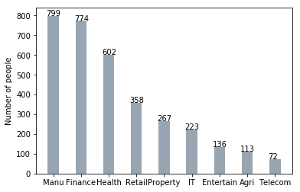
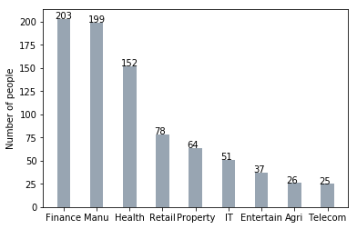
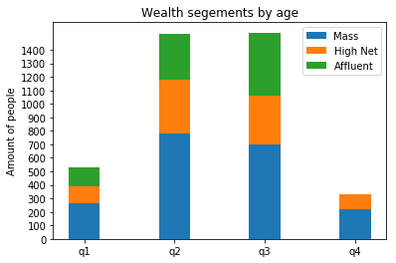
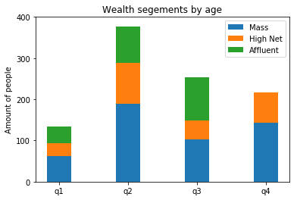
Note: The data and information in this document is reflective of a hypothetical situation and client. This document is to be used for KPMG Virtual Internship purposes only.
Interpretation
Job industry category
Mostly our new customers are on Finance industry and our Manufacturing customers are still on top 2.
The rest industries is still same
Wealth segments
In all ages, the number of Mass Customers is the highest so we should focus on this social class.
After that, we should focus on High Net Customer.
Then Affluent Customers but mostly second and third quadrant

Slide 7
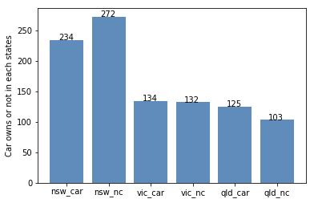
Note: The data and information in this document is reflective of a hypothetical situation and client. This document is to be used for KPMG Virtual Internship purposes only.
Interpretation
Numbers of cars owned
NSW should be considered the most since numbers of customers don’t own cars is significantly larger than that own.
VIC and QLD has more customers that own car that who don’t but we can try to have something so that those owns car will buy bikes.
Place any supporting images, graphs, data or extra text here.

Slide 8
Note: The data and information in this document is reflective of a hypothetical situation and client. This document is to be used for KPMG Virtual Internship purposes only.
Appendix

Slide 9
Note: The data and information in this document is reflective of a hypothetical situation and client. This document is to be used for KPMG Virtual Internship purposes only.
Appendix
All supporting items in that attachment.

